Slide 1
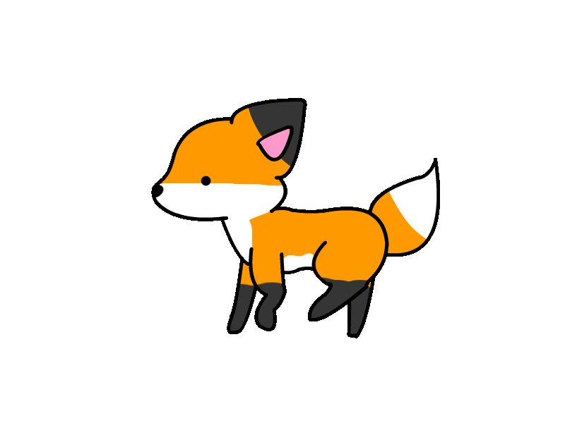
Night Fox：
A Communication Assistant Application for Paralyzed People based on Eye tracking and Sketch Recognition
Final project for CSCE 624 Sketch Recognition.
Bing Jiang, Chao Gu, Qiancheng Liu, Aniket Bonde, Paul Taele, Tracy Hammond

Slide 2
Overview and Motivation
Tracking eye movement is widely used in Cognitive Research, Medical Service, and many other areas.
Why it’s not good?
It’s expensive and its application is highly limited to several areas.
Why it’s not solved?
The price is high due to the requirement of special camera.
Applications based on eye tracking are not very common
For some simple needs, such as eating, instead of typing in a word “Hamburger” need to gaze for some specific time.

Slide 3
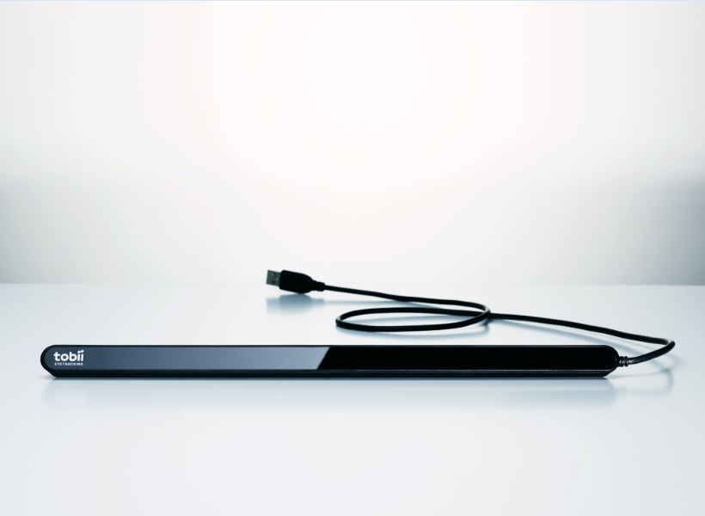
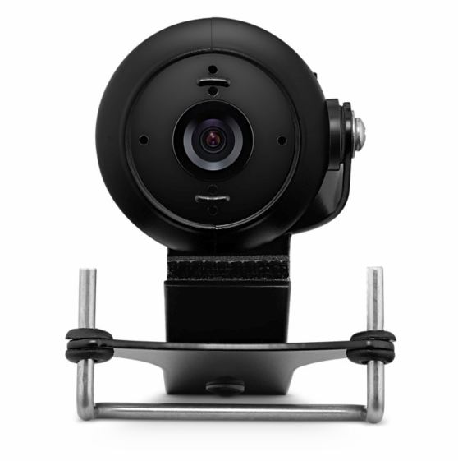
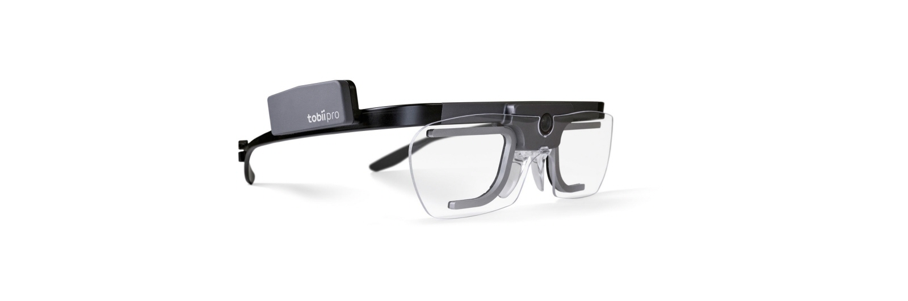
Related Work (Domain Work)
$699
$199
$549

Slide 4
Related Work (Technical Work)
PyGaze: Open-source toolbox for eye tracking in Python (not good enough).
Pupil: Open source eye tracking software platform in Python and C++, that started as a thesis project at MIT (needs specialized camera setup).
WebGazer.js: Our project uses the library WebGazer that was presented by Alexandra Papoutsaki, 2016.
WebGazer is a new approach for scalable and self-calibrated eye tracking on the browser using webcams.
Used Ridge Regression to find predicted eye gazing to overcome noise.

Slide 5

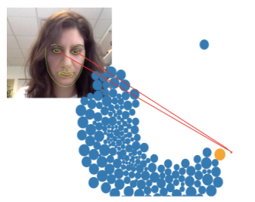
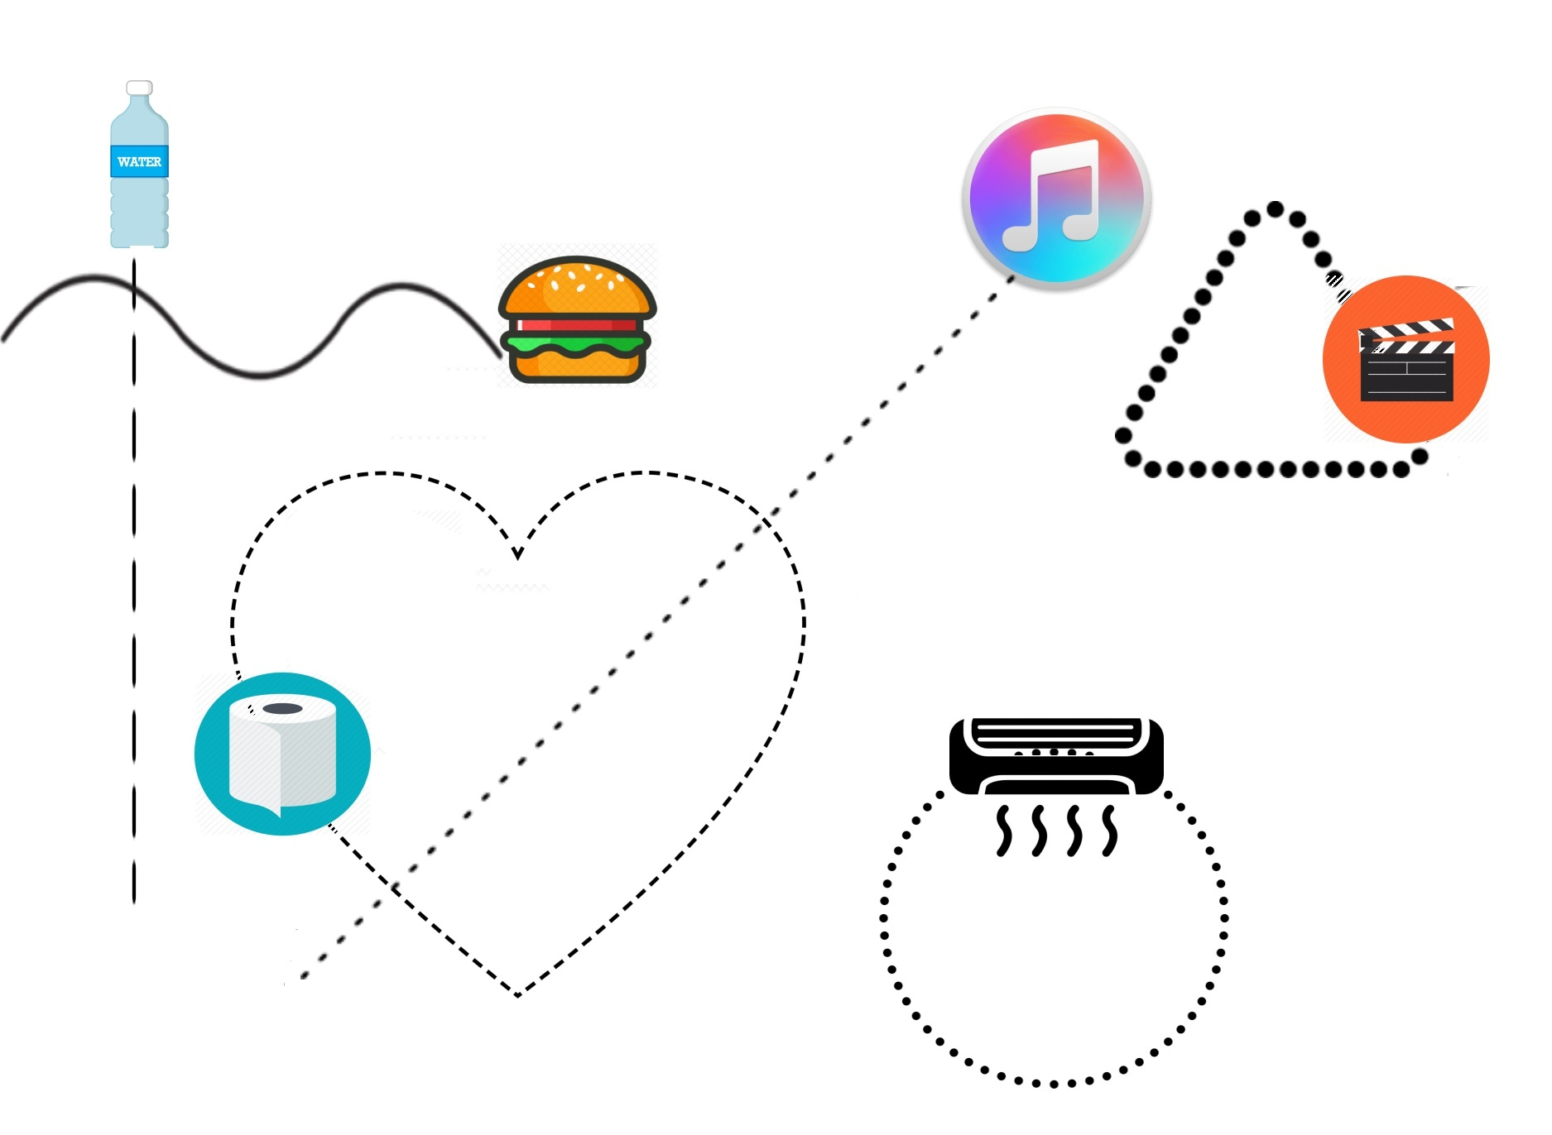
Proposed Solution Overview
WebGazer.js
Democratizing Webcam Eye Tracking on the Browser
Gather preliminarily eye movement with regular webcam
Generate usable eye-sketching data based on eye movement
Implement an web-based interface using Node.js
Applying sketch recognition methods to match the eye movement path with items’ movement path
Pre-processing
Rubine’s features
Template matching
The system give user feedback or respond based on the result.

Slide 6
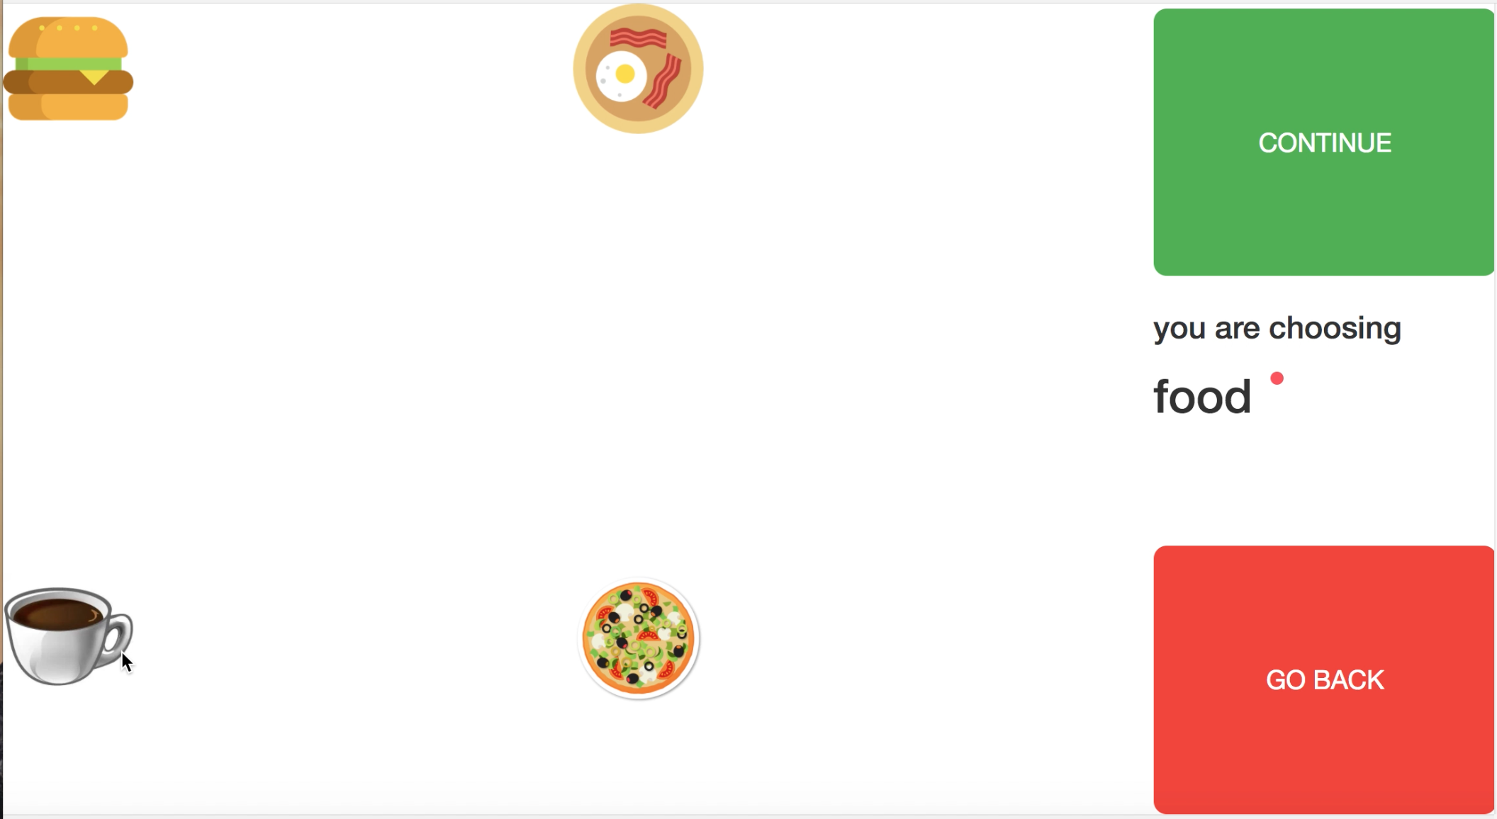
Interface Design and Interaction
Directory User Interface :
Four moving objects on the left which represent the select options for the user.
Two big buttons on the right which are used for confirmation and return.
Supplementary information between two buttons
A clean & simple interface is required to avoid distraction

Slide 7

Interface Design and Interaction
Final User Interface :
Display the content of the final selection, including movies, books, food.
The two side buttons ensure if the selection is correct.

Slide 8
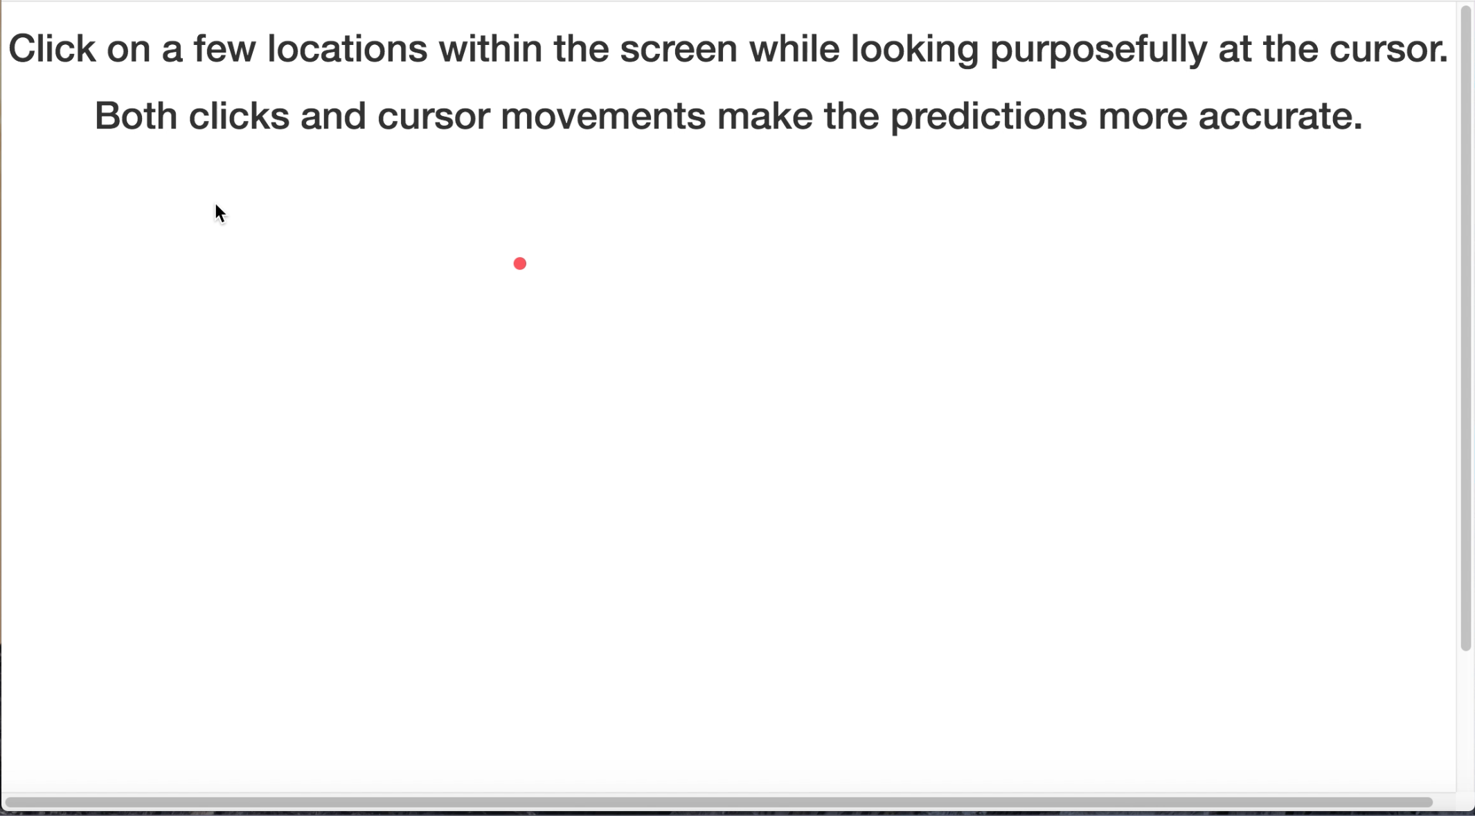
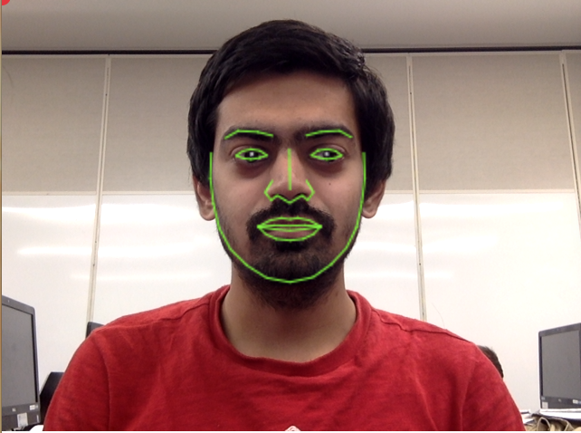
Data Collection
Data is continually collected by WebGazer.js every 10 milliseconds.
Collected data are considered as stroke points for about 1.5 seconds.

Slide 9
Stroke Recognition (Pre-Processing & Features)
Pre-process :
Mean value of the x and y coordinates of the start and end 15 points of the stroke
Features :
Cosine between the start and end points
Sine between the start and end points
Counter for hitting Button areas “Yes”&”No”

Slide 10
Stroke Recognition
Five strokes form one sketch for recognition.
Template Matching is applied for sketch recognition on this eye-traced stroke to determine which item user was following.
Nomenclature:
R - Moving right
L - Moving left
U - Moving Up
D - Moving Down
N - Hitting “No” more than “Yes”
Y - Hitting “Yes” more than “No”

Slide 11
Sketch and Button Recognition
Hamming Distance between sketch and Templates are calculated.
If sketch is [‘L’,’L’,’U’,’L’,’D’],
Item 1 -> [0,0,1,1,1] -> Score = 3 (winner)
Item 2 -> [1,0,0,0,0] -> Score = 1
Item 3 -> [0,0,0,0,0] -> Score = 0
Item 4 -> [0,1,0,0,0] -> Score = 1
Correct -> [0,0,0,0,0] -> Score = 0
Incorrect -> [0,0,0,0,0] -> Score = 0
Templates:
['D','R','U','L','D'] -> Item 1
['L','D','R','U','L'] -> Item 2
['R','U','L','D','R'] -> Item 3
['U','L','D','R','U'] -> Item 4
[‘Y’,‘Y’,‘Y’,‘Y’,‘Y’] -> Correct
[‘N’,‘N’,‘N’,‘N’,‘N’] -> Incorrect

Slide 12
Evaluation
Experiment Design :
Stroke recognition part is tested independently on local server.
The whole design was tested by all group members and randomly selected 10 participants.
No pre-trained data was used. Train eye tracker and get familiar with the system.
We inserted the “alert information” after each phase so we can take notes of the result, Then the system continues. But users are not allowed to use mouse or keyboard.
Raw Result :
Correct sketch recognition results were counted manually during the test.

Slide 13
Evaluation 1 : Sketch Recognition
Recognition accuracy for eye movement
Experiment design:
Under ideal environment, user is following an item, and the system will alert an array of directions
50 experiments, accuracy
Direction | Accuracy
Left | 76%
Right | 72%
Up | 60%
Down | 70%

Slide 14
Evaluation 1 : Sketch Recognition
Recognition accuracy for Gaze
Experiment design:
Under ideal environment, User stare at a button, and the system alert array of ‘Y’ or ‘N’
50 experiments, accuracy
Gaze | Accuracy
Continue | 82%
Go back | 64%

Slide 15
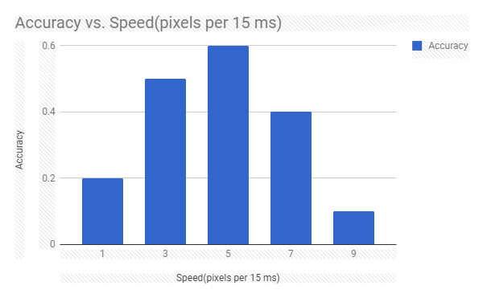
Evaluation 2 : System Performance
Items movement speed:
Randomly select a user to test the system when items are running at different speed
Users task : select the required items with their eyes.
Accuracy: success without going back

Slide 16
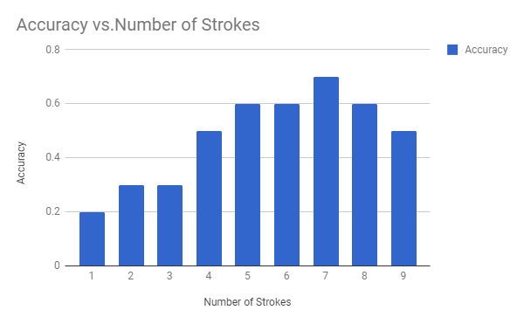
Evaluation 2 : System Performance
Number of strokes:
Randomly select a user to test the system when of items are running at different number of strokes

Slide 17
Evaluation 2 : System Performance
Environment:
Randomly select 10 users to use our application. They are asked to perform two experiments.
First experiment is under noisy environment (Annex library, not bright light, wear glasses, using laptop)
Second experiment is in ideal environment, background. (Good lighting,no glasses, a better web camera, good distance in front of camera)
Users task : select the required items with their eyes.
Accuracy: success without going back
Experiment | Accuracy
Noisy | 50%
Ideal | 70%

Slide 18
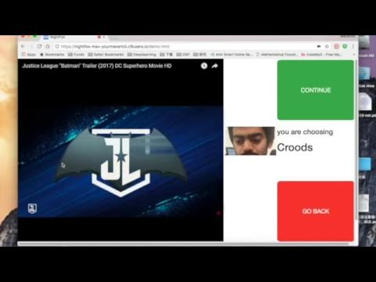
Demo Video

Slide 19
Discussion
Interesting Result :
The position of the button on the screen great influence on accuracy
The speed and strokes of the moving objects has great influence on accuracy
Keep your eyes large open can help improvement the accuracy.
Similarly, the distance between the user and camera has huge effect on the accuracy
After using the system for some time, the accuracy will start dropping greatly.
(over training with noisy data, nothing we can do)

Slide 20
Conclusion
Strengths:
Our application can satisfy user’s need to select items by eyes.
The application is a website, so if we push it online, anyone can use it with their own device.
The application runs entirely in the client browser, so no video data needs to be sent to a server.
Weaknesses:
The recognition is limited by the resolution of webcamera and the algorithm behind eye tracker API.

Slide 21
Future Work
User Experience Improvement :
Adjust the layout of the User Interface improvement the accuracy
Recognition Improvement :
Improve regression algorithm in WebGazer which is foundation of this application
With a better camera, or a better eye tracker, we can try to expand our selection system :
more items
more complicated object moving paths.
Function:
connect to shopping website
connect to fast food restaurant like Mcdonald’s
games allow user to change soldiers running and shooting.

Slide 22
Questions?

